Slide 1
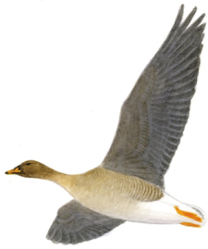
Data on Bean Goose hunting in SwedeN
Data on Bean Goose hunting in SwedeN
Niklas Liljebäck

Slide 2
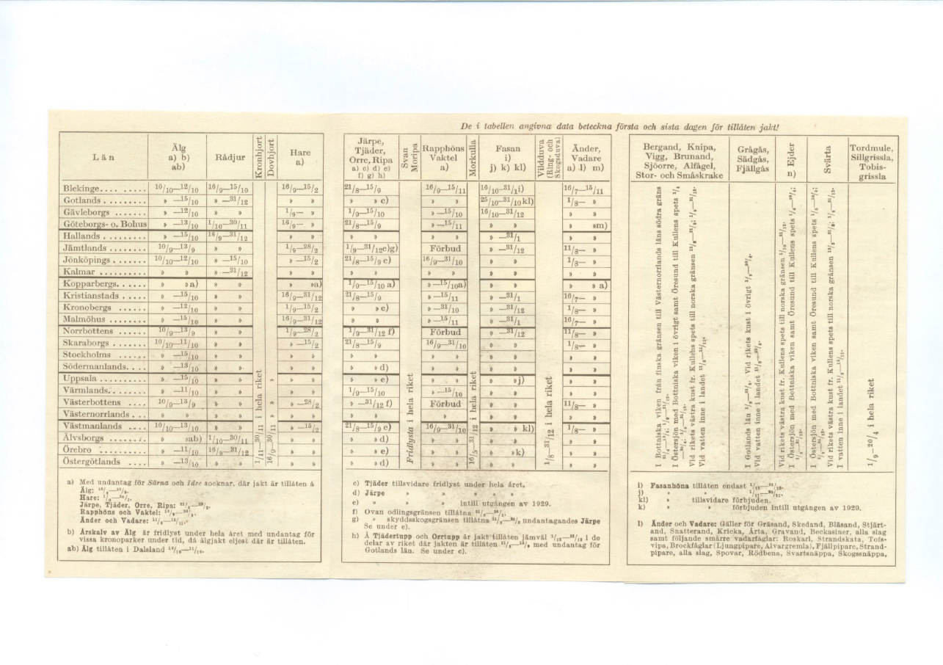
Bean goose has a long history as quarry species in Sweden
iData on Bean Goose hunting in SwedeN
Hunting periods 1928!
Greylag-,Bean-, and Lesser White fronted Goose:
On island of Gotland 1 sept to 31 march.
By the cost of the Kingdom 1 sept to 20 april.
Inland waters 11 aug to 20 april.

Slide 3
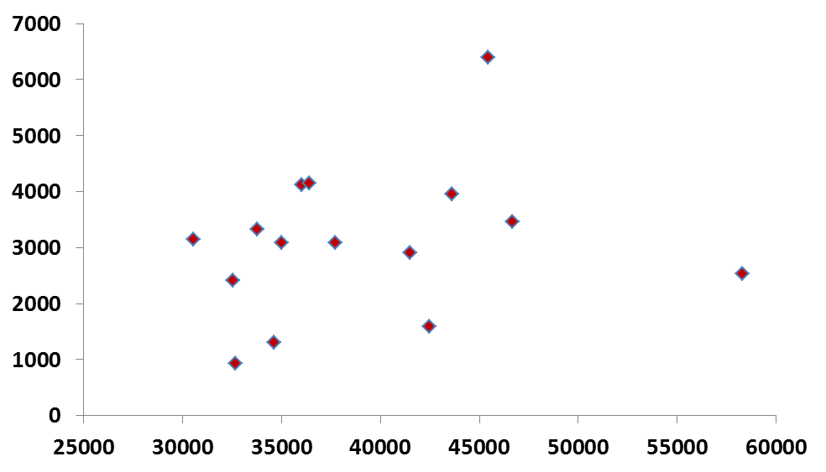
Bean Goose bag vs Goose count data
Data on Bean Goose hunting in SwedeN
No relation between winter/atumn counts
and harvest levels!

Slide 4
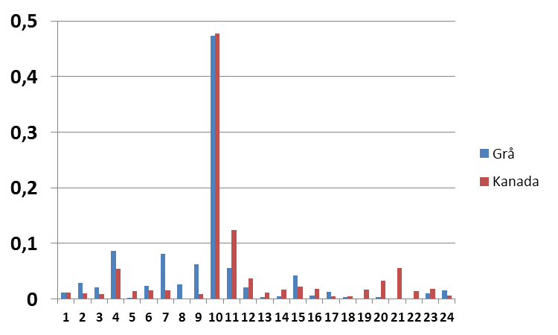
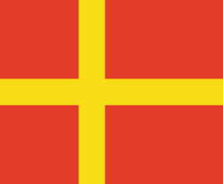
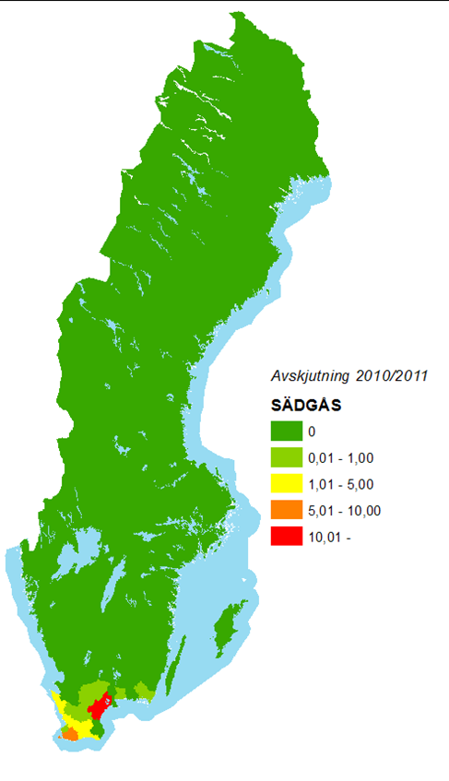
Proportion of total goose harvest among different countys in sweden
Data on Bean Goose hunting in SwedeN
Proportion of total bag
Skåne
Hl
County

Slide 5
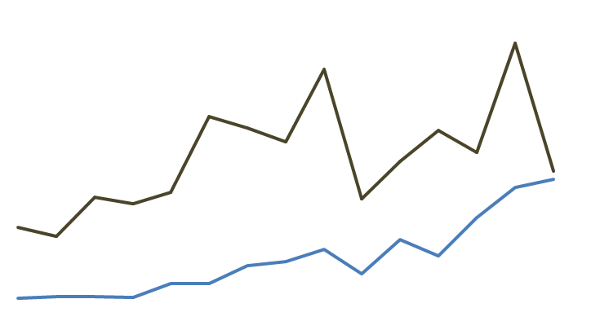
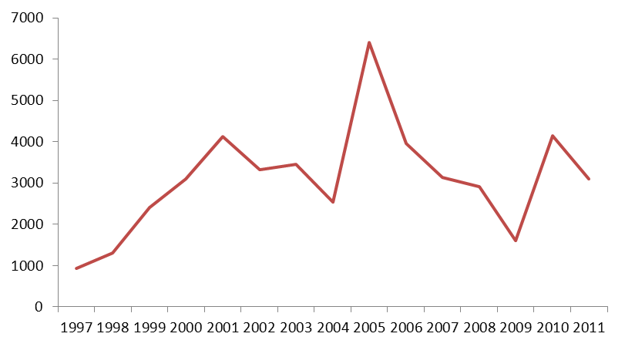
Bean goose bag in Sweden 1997-2011 (”hunting years” i.e. 2011 corresponds to 2011/2012
Data on Bean Goose hunting in SwedeN
50000
Canada goose
25000
Mean 3100
Greylag Goose
5000

Slide 6
High variation in Bean goose bag due to climate!?
Data on Bean Goose hunting in SwedeN
Depending on climate during autumn/winter high numbers of Bean Geese
spend long time in Skåne
Certain winter conditions creates favourable conditions for hunting.
Common pattern for Canada- and Bean Goose
© Sten Christoffersson

Slide 7
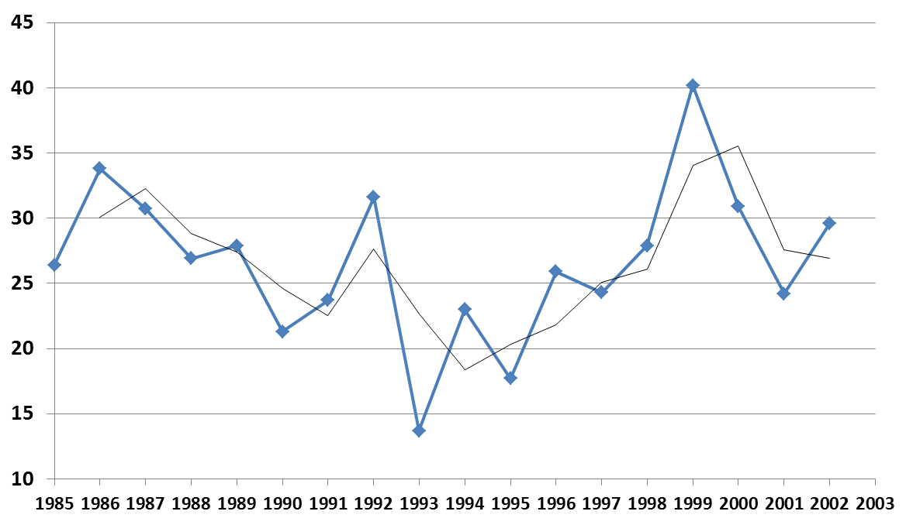
Proportion of 1 cy-birds in the total bag of Bean Goose in one estate in eastern Scania 1985-2002
Data on Bean Goose hunting in SwedeN
GG
% of
tot bag
Can
GG
GG
GG
Can
GG
Can
Can
Can
Can = Canada Goose
Can
GG = Greylag Goose

Slide 8
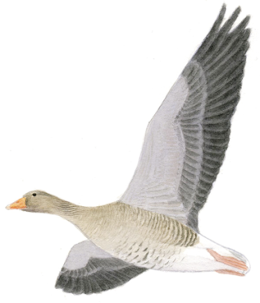
Sex ratio in Bean-, Greylag- and Canada goose bag at different estates respectively
Data on Bean Goose hunting in SwedeN
Species | Year | % male in ad | % male in 1cy-birds
Bean Goose | 1985-1997 | 51.8 | 46.8
Greylag Goose | 1989-1998 | 50.3 | 48.9
Canada Goose | 1986-1997 | 49.5 | 46.6

Slide 9
Results from ”Interviews”!
Data on Bean Goose hunting in SwedeN
Countyboards - three out of four (not inc. Skåne) that may allow protective hunting
on Bean Goose
Know about the situation for bean goose population- highly restrictive
Few birds shot – ”some tens” per County
Some substitutes for Bean Goose-damage in one County
Larger estates in Skåne that have ”professional game management”
and hunt for Bean Goose
Some income from bean goose hunting- hard to set to species level
More importan as a tool to reduce conflict with agriculture interest
Bean Goose have high status but today few hunting events focus on Bean Goose
Harder restrictions will increase agricultural conflict

Slide 10
Thank you!
Data on Bean Goose hunting in SwedeN

Slide 11
Proportion of 1 cy-birds in the total bag of Bean Goose in one estate in eastern Scania
1985-2002
GG
% of
tot bag
Can
GG
GG
GG
Can
GG
Can
Can
Can
Can
Can = Canada Goose data from other estate
GG = Greylag Goose data from other estate

Slide 12
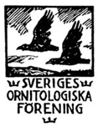
Comments from Birdlife Sweden SOF
Highly value the initative to work with a a

Slide 13
The goose situation in Sweden and hunters
Hunters having a lot of obligations i.e. reduce conflicts
accompinied with increasing populations of deers, wildboar, geese
Protective hunting and other measures to prevent crop damage
mostly done by ordinary hunters

Slide 14
Bean goose has a long history as quarry species in Sweden- traditional?
Hunting periods 1928
Greylag-,Bean-, and Lesser White fronted Goose:
On island of Gotland 1 sept to 31 march.
By the cost of the Kingdom 1 sept to 20 april.
Inland waters 11 aug to 20 april.

Slide 15
Bean Goose bag vs Goose count data
No relation between winter/atumn counts
and harvest levels!

