Slide 1
Successful Harvest Reporting and Human Dimensions of Waterfowl Hunting Regulations: How to make things work
Craig A. Miller
Human Dimensions Research Program
Illinois Natural History Survey
University of Illinois (USA)

Slide 2
US Fish and Wildlife Service Adaptive Harvest Management Framework
Hunting season lengths and maximum harvest set each year by U.S. Fish and Wildlife Service (USFWS)
Allow for 30, 45, or 60-day seasons
Specific dates set by each state wildlife agency
USFWS allows for up to 3 state zones and split seasons (in for 2 weeks, out for ~2 weeks, then in for remainder of maximum) OR 4 state zones

Slide 3
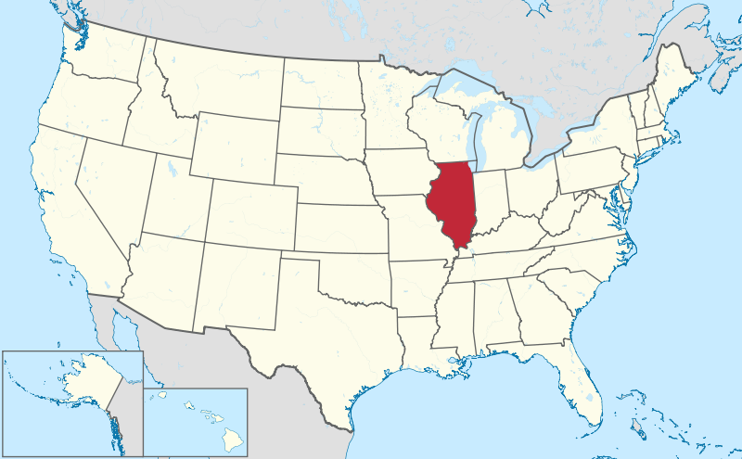
State of Illinois, USA

Slide 4
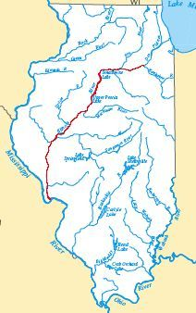
Rivers of Illinois

Slide 5
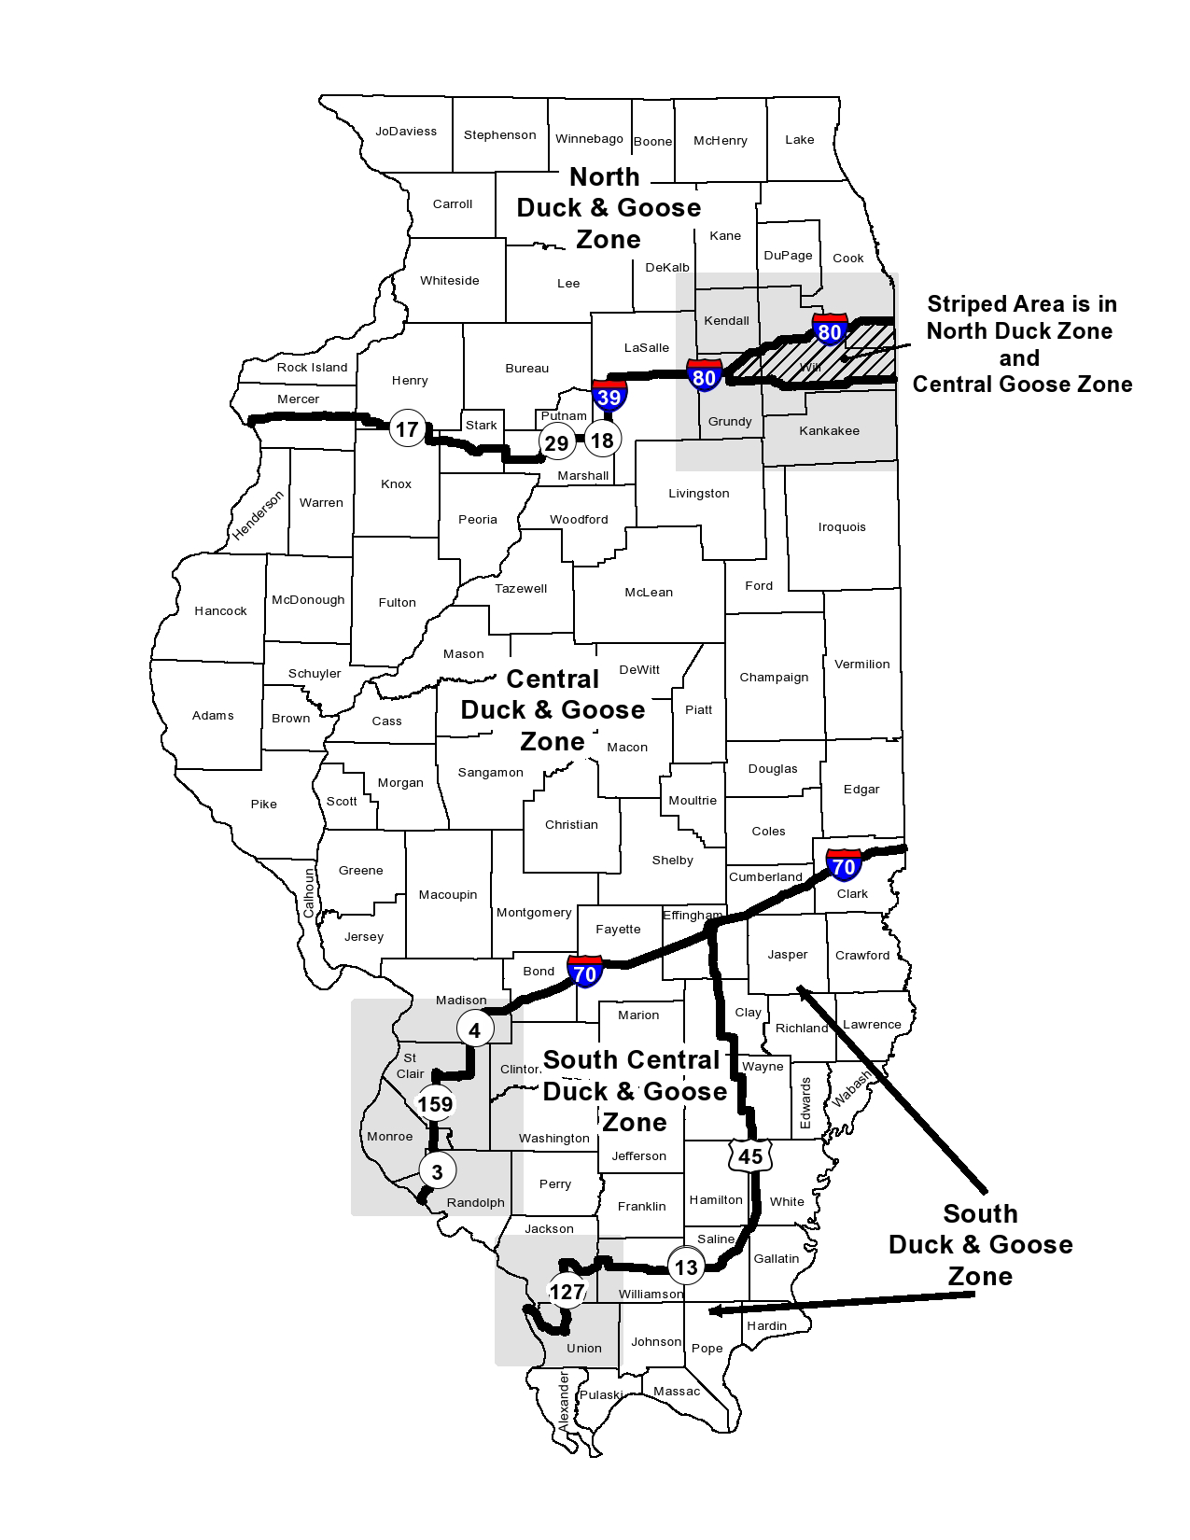
Illinois Waterfowl Zones

Slide 6
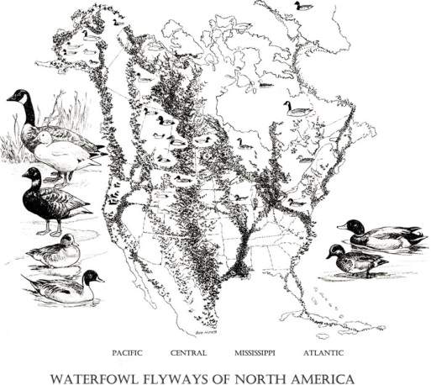
North American Flyways

Slide 7
Hunters and Flyways
There is latitudinal as well longitudinal relationship
Seasons – hunter preferences for mid-season to coincide with peak migration, avoid freeze dates
Methods – e.g., Spinning-wing Decoys
Some hunters also blame duck numbers on harvest in other states in the flyway

Slide 8
Waterfowl Research Illinois Natural History Survey
Illinois Natural History Survey founded in 1858
Began modern era of waterfowl research with Frank Bellrose in 1940s
1947 - present conduct weekly inventory flights to count waterfowl (01 September – 30 January)
Conducted early studies on lead shot ingestion in waterfowl
Bellrose Waterfowl Research Center
Annual waterfowl harvest surveys began in 1980

Slide 9
Illinois Natural History Survey Waterfowl Harvest Surveys
Annual mail survey of 5,000 waterfowl hunters randomly selected from 50,000 – 60,000 waterfowl hunters in the state of Illinois
Before season begins sampled hunters mailed harvest cards to record individual harvest of mallard, wood duck, canvasback, and other duck species, plus Canada goose and other geese
Hunters also asked to record number of days and counties hunted
Following season hunters mailed 8-page survey questionnaire aimed at harvest, regulations, and other policy issues

Slide 10
Pre-season Goose Harvest Card
Date of Hunt | Zone Hunted | County Hunted | Sept. Canada Geese | Canada Geese | Snow/ Blue/ Ross’ Geese | White-fronted (Speckle-belly) Geese | Geese downed not retrieved | # of Shots Taken

Slide 11
Annual Waterfowl Harvest and Hunter Surveys
Illinois Waterfowl Hunter Survey (annual harvest survey)
Illinois Snow Goose Hunter Survey (Chen caerulescens) - annual survey of special light goose spring season
Pre- and Post-Duck Season Hunter Survey

Slide 12
2012-13 Illinois Waterfowl Harvest
50,740 hunters
1,155,346 days afield
580,557 total birds harvested
29% hunted ducks only
10% hunted geese only
61% hunted both
Total 90% hunted ducks, 71% hunted geese

Slide 13
Duck Harvest
43,444 hunters
630,223 day afield
244,988 mallards (Anas platyrhynchos)
47,623 wood ducks (Aix sponsa)
185,776 other ducks
478,387 total ducks
4,133 American coots (Fulica americana)

Slide 14
Goose Harvest
34,034 hunters
386,356 days afield
72,682 Canada geese (Branta canadensis)
19,597 other geese
92,280 total geese

Slide 15
Science of Harvest Surveys
Harvest surveys involve psychological considerations
Hunters subject to certain bias in reporting harvests
Recall bias
Digit Preference
Cultural factors
Nonresponse bias

Slide 16
Recall Bias
Difficulty recalling events accurately over time
Telescoping – recall earlier events as though closer in time
Using memorable event as typical of others
Difficulty separating events into discrete segments

Slide 17
Digit Preference
Preference given to reporting harvest or days afield in digits ending in 0 or 1
Season harvest may be reported as multiples of individual days

Slide 18
2002-03 Illinois Duck Harvest

Slide 19
2002-03 Illinois Duck Hunter Days

Slide 20
Cultural Factors
Over-estimate harvest to “assist” agency
Under report harvest to mislead agency
Not respond due to attitudes toward “government”

Slide 21
Nonresponse Bias
Bias in key factors contributing to nonresponse to survey
Question sometimes arises:
“Do hunters respond to surveys because they harvest more/less than ‘average’?”
Answer: No

Slide 22
Current Research
Checking hunter daily bags at state hunting areas and after season survey to note recall accuracy.
Send pre-season harvest card to 5,000 hunters and not to 2,000 – and both get post-season survey

Slide 23
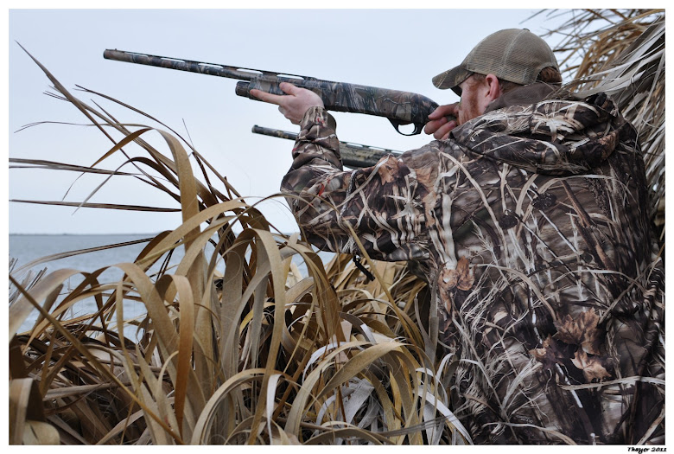
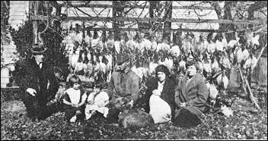
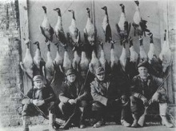
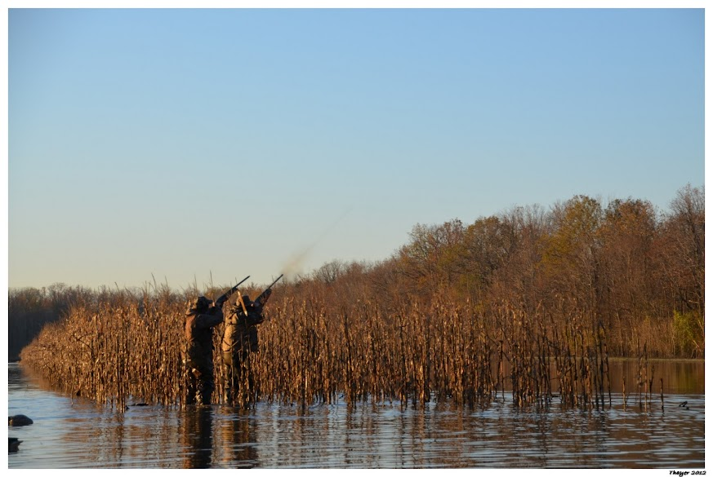
Waterfowl Hunting Traditions Past and Present

Slide 24
New Hunting “Forces” and Harvest
Hunting videos – depict harvest and success to a greater degree than reality
In U.S.A., viewed by a majority of younger hunters
May be providing a skewed perspective on hunting success and harvest
New and increasingly technical equipment to maximize harvest

Slide 25
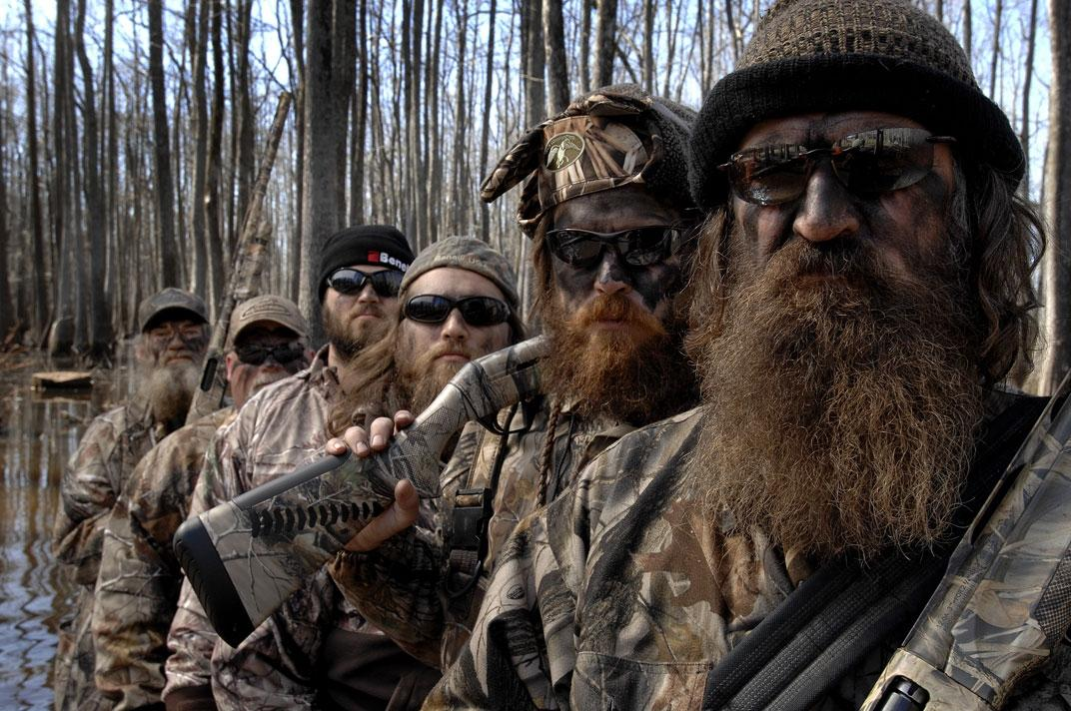

Slide 27
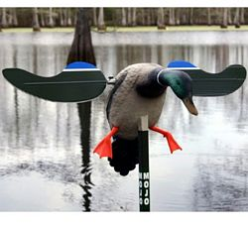
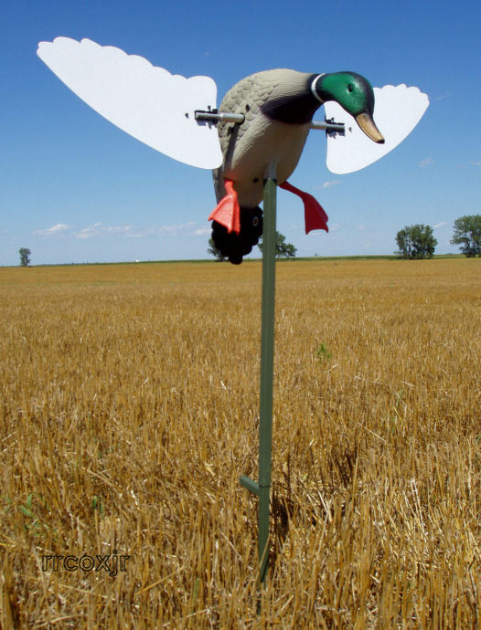
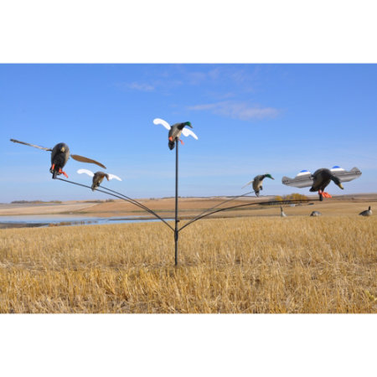
Spinning-Wing Decoys

Slide 28
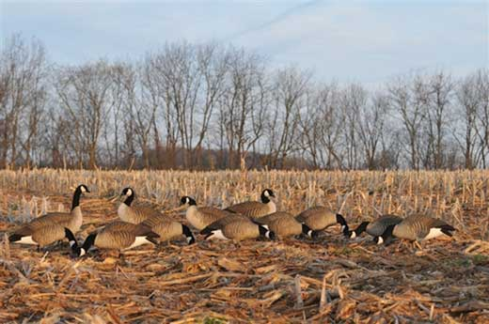
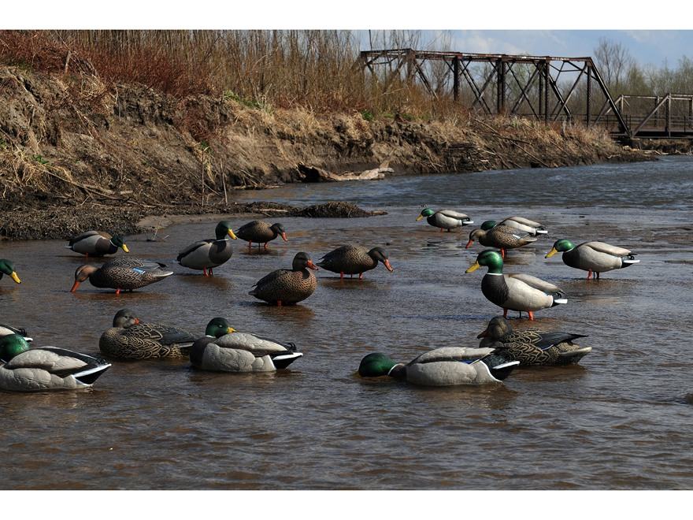
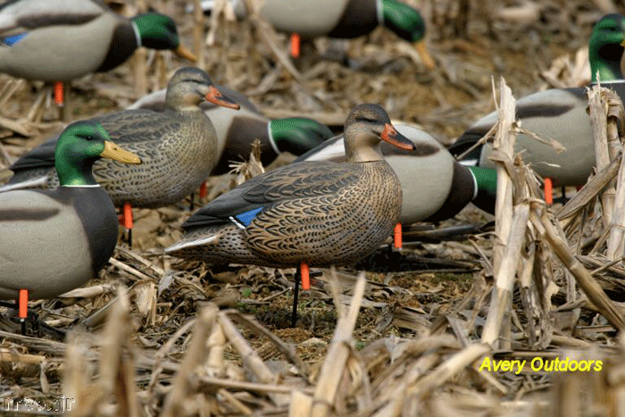
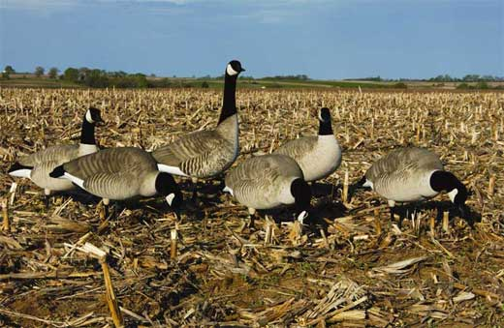
Full-body Decoys

Slide 29
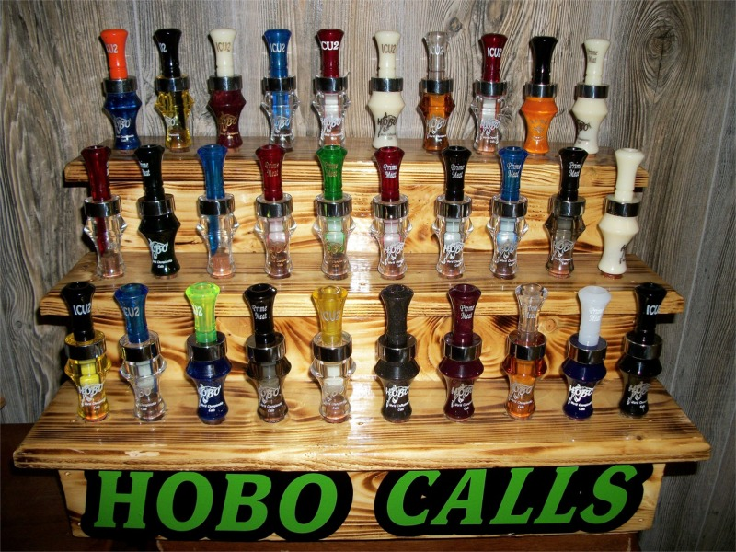
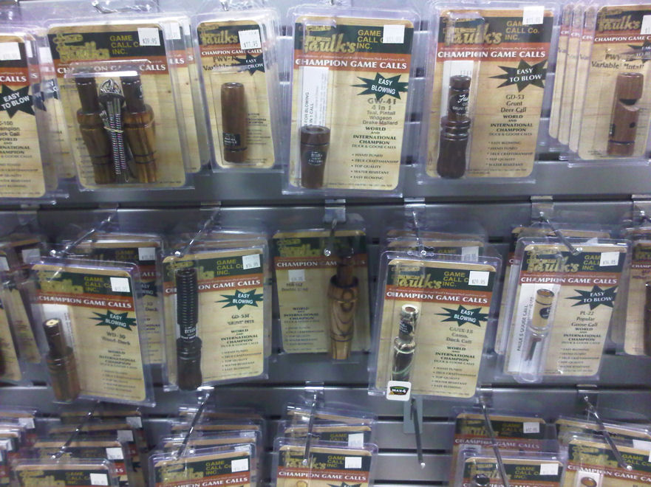
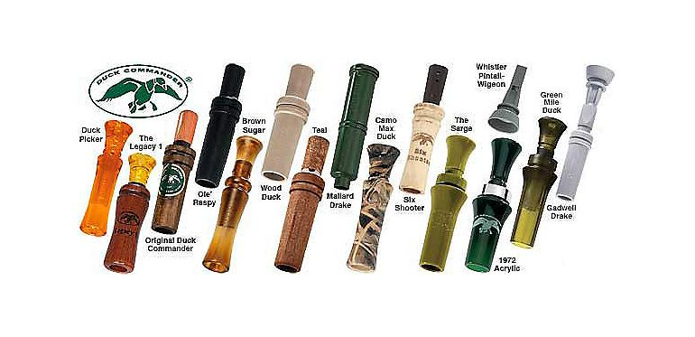
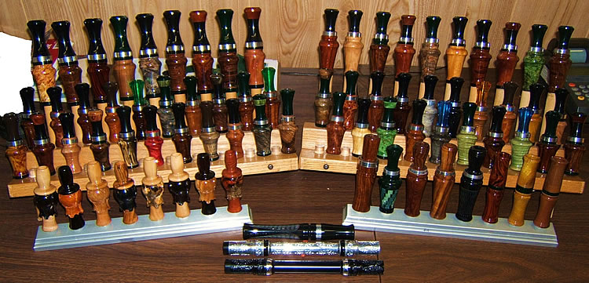
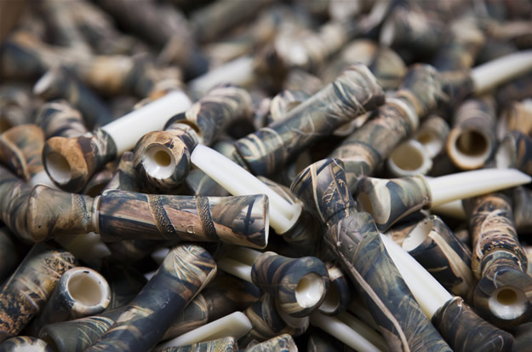
Calls

Slide 30
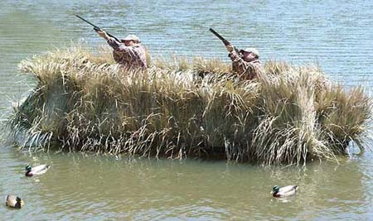
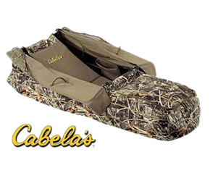
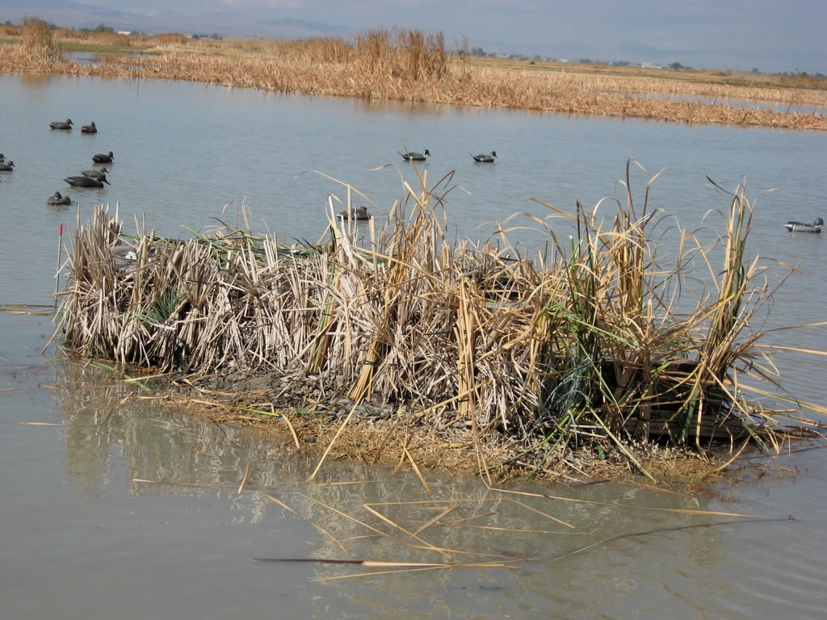
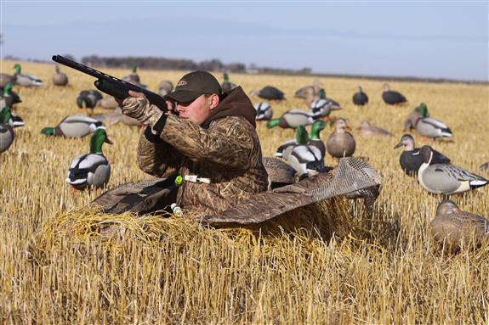
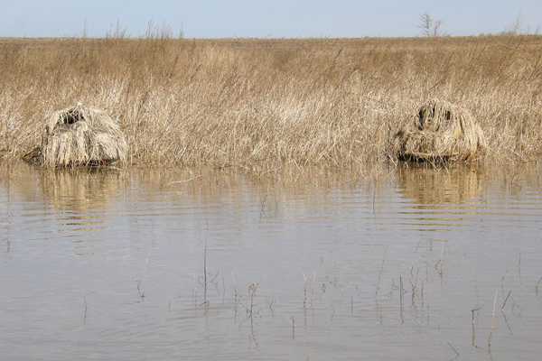
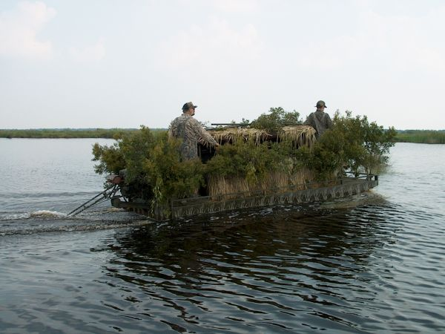
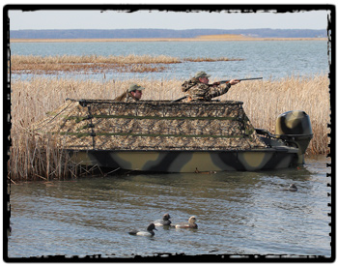
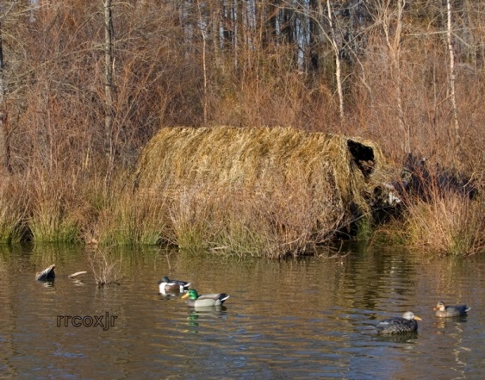
Blinds

Slide 31
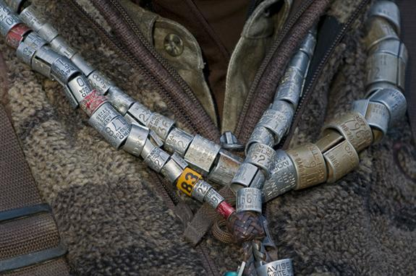
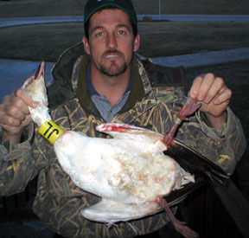
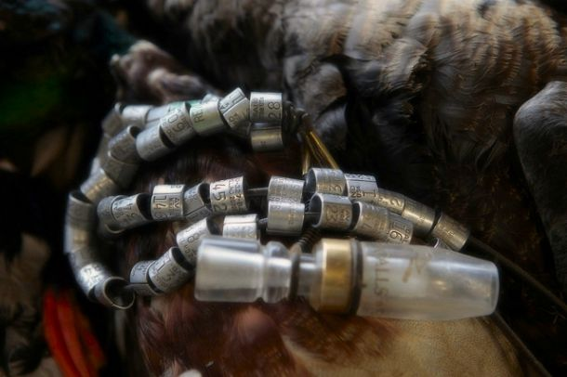
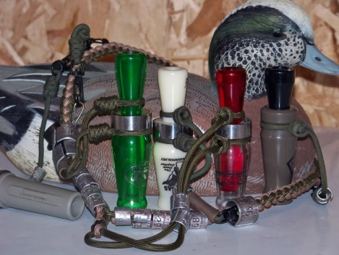
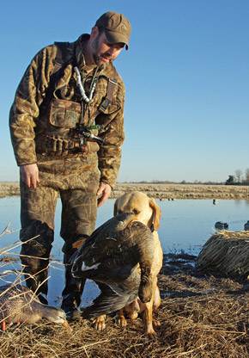
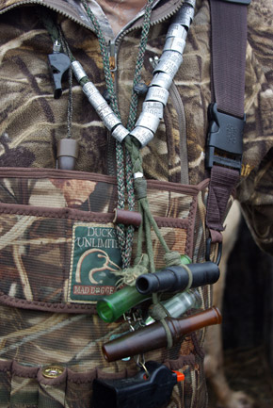
Waterfowl Bands

Slide 32
Human Dimensions
Challenges are to understand trends in hunter behaviors that may influence harvest
Understanding motivations and preferences of hunters will help predict impacts on harvest and populations
Research will allow to be proactive in anticipating new approaches, rather than be reacting to them

Slide 33
http://wwx.inhs.illinois.edu/index.php?cID=327
craigm@illimnois.edu

Slide 34
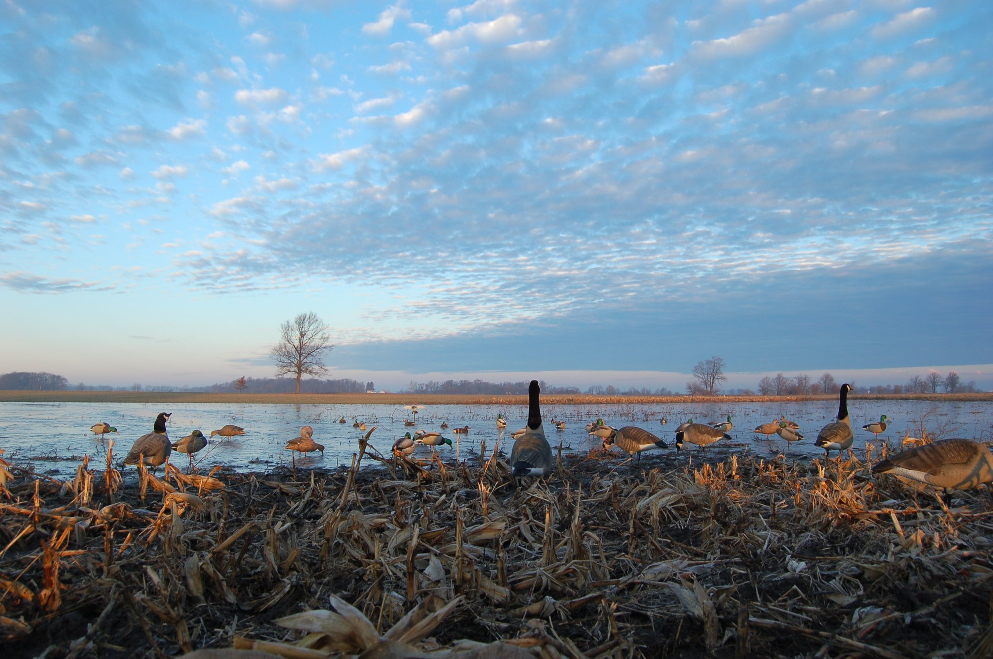
Thank you

